Slide 1
These Thy Atoms
Stacy A. Trasancos, Ph.D.

Slide 2
Schedule
8:45 – 10:00 Pre-Lab
10:00 – 10:15 Break
10:15 – 10:45 Lab Activity: Flame Testing (Metal Salts)
10:45 – 11:15 Lab Activity: Flame Testing (Unknowns)
11:15 – 11:30 Lab Activity: Flame Testing (Hypothesis)
11:30 - 12:00 Post-Lab

Slide 3


Slide 4
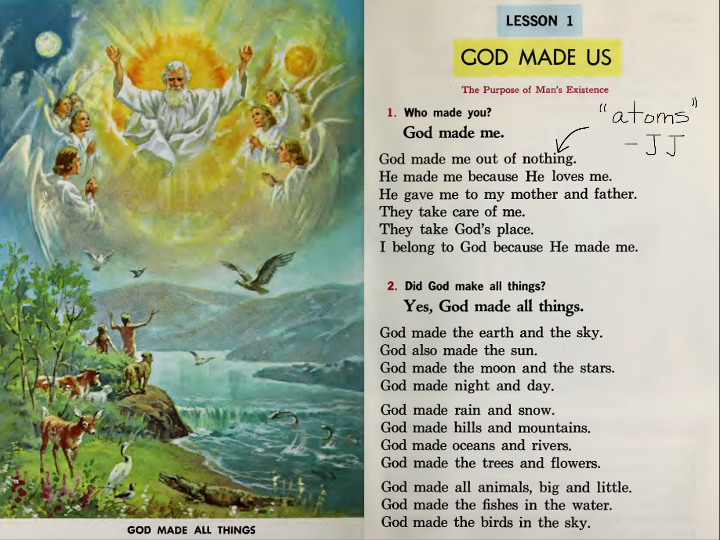

Slide 5
Lecture
Come on down into the world of atoms.

Slide 6

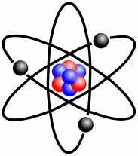
Put your chemistry glasses on.
Notes:
p+ 1.672 621 898 e -27 kg
n° 1.674 927 471 e -27 kg
billionths of a billionth of a billionth of a kilogram
e- 1/1836 mass of p+
e- 9.109 383 56 e -31 kg
+/- 1.602 176 6208(98) e -19 C
C = 1A x 1s (constant current in 2 straight parallel conductors, infinite length, negligible circular cross-section, 1 meter apart in a vacuum that produce a force equal to 2e-7 N/m, F=ma, in kg m/s^2)
How mass determined? Wiki
Quarks and the mass of a proton
In quantum chromodynamics, the modern theory of the nuclear force, most of the mass of protons and neutrons is explained by special relativity. The mass of a proton is about 80–100 times greater than the sum of the rest masses of the quarks that make it up, while the gluons have zero rest mass. The extra energy of the quarks and gluons in a region within a proton, as compared to the rest energy of the quarks alone in the QCD vacuum, accounts for almost 99% of the mass. The rest mass of a proton is, thus, the invariant mass of the system of moving quarks and gluons that make up the particle, and, in such systems, even the energy of massless particles is still measured as part of the rest mass of the system.
Two terms are used in referring to the mass of the quarks that make up protons: current quark mass refers to the mass of a quark by itself, while constituent quark mass refers to the current quark mass plus the mass of the gluon particle field surrounding the quark.^{[25]:285–286} ^{[26]:150–151} These masses typically have very different values. As noted, most of a proton's mass comes from the gluons that bind the current quarks together, rather than from the quarks themselves. While gluons are inherently massless, they possess energy—to be more specific, quantum chromodynamics binding energy (QCBE)—and it is this that contributes so greatly to the overall mass of protons (see mass in special relativity). A proton has a mass of approximately 938 MeV/c², of which the rest mass of its three valence quarks contributes only about 9.4 MeV/c²; much of the remainder can be attributed to the gluons' QCBE.^{[27][28][29]}

Slide 8
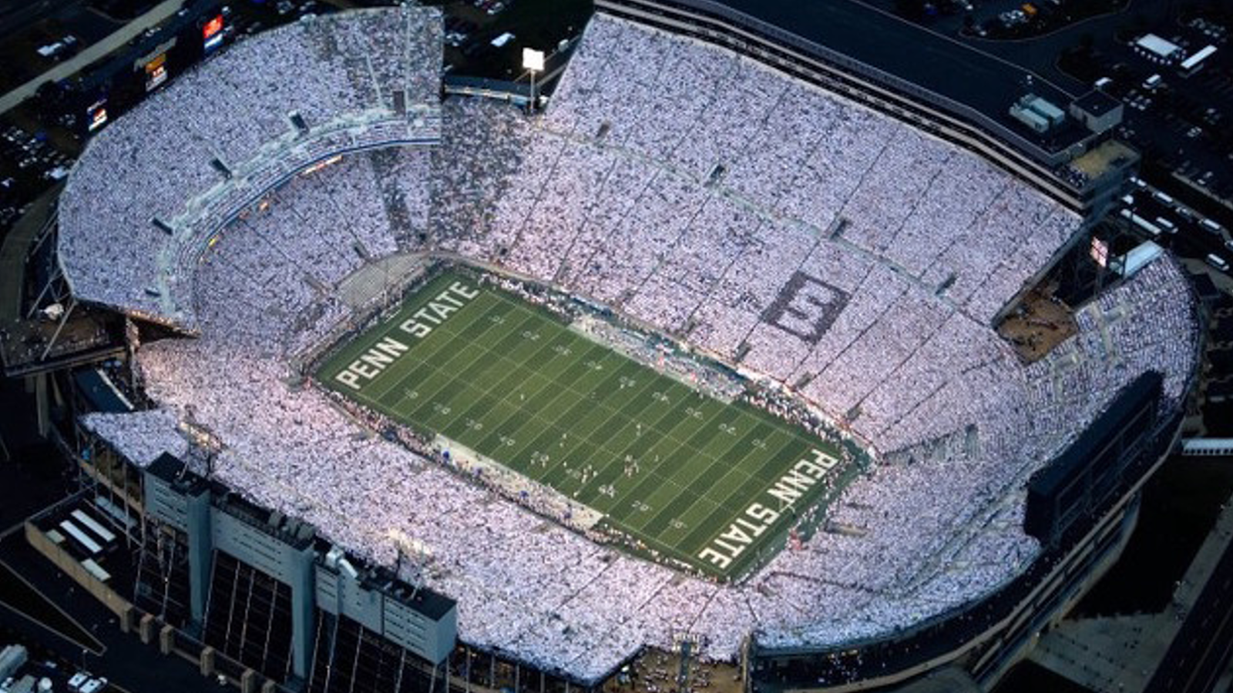
mass of a proton = 1.6726219 × 10⁻²⁴ grams

Slide 9
Light and color come from inside the atom.

Slide 10
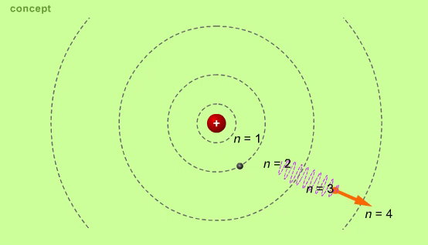
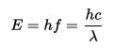
Bohr, Photons, and Spectral Lines
Orbits (and energy levels) are quantized
∙ Only certain energy changes possible
Photons of light are quantized
∙ Energy = Planck’s constant times frequency
∙ Observed spectral lines match energy differences
Principles of Physics Online version 2.20.002 | © 2001-2010 Kinetic Books Company | Chapter 41.11
Notes:
The Greek philosopher, Democritus, used the word ἄτομον (atomon) to describe indivisible particles and taught that everything is the result of natural laws, a conclusion the faithful reject. But we use our knowledge of atoms gained in the last 200 years to marvel at God’s design.
The concept of atoms reemerged in the work of John Dalton in the early 1800s. From his work with gases, Dalton formulated a theory that elements are composed of indivisible particles that combine in whole-number ratios to form compounds. Then scientists discovered that atoms are made of more elementary particles. J. J. Thompson discovered electrons in 1897. In 1900, Max Plank proposed that atoms release or absorb energy in small, fixed amounts; he called a single packet a “quantum.” Robert Millikan calculated the mass and charge of electrons in 1909. Ernest Rutherford found nuclei and protons in 1911. Niels Bohr proposed his planetary atomic model in 1913. In 1924, Louis de Broglie postulated the concept of matter waves, that matter can exhibit wave-like behavior. Werner Heisenberg proposed the “uncertainty principle,” that the dual nature of matter means we cannot know the momentum and location of subatomic particles simultaneously. In 1926, Erwin Schrödinger devised a “wave function” to describe the behavior of the electron.
-----
From textbook: Here, we review how quantum theory explained spectral lines. We will start with Bohr’s model of the atom. He said that the orbits and their corresponding energy levels were quantized. An electron could only exist at certain orbital radii, such as those shown. An absorbed or emitted photon would cause the electron to change orbits.
----
Since only certain orbital energy levels were possible, only certain changes in energy were possible. In this animation, an electron moves to a lower energy orbit, lowering its total energy, and emits a photon that takes away the energy.
----
Einstein showed that light was quantized, that it consisted of photons. Here we show a photon being emitted by an atom.
----
Einstein also concluded that the energy of the photon equaled Planck’s constant times its frequency. The energy of the photon would be determined by the change of energy of the electron. Only certain changes in the energy of the electron were possible, since it could exist only in certain orbits. This meant the atom would only emit photons of particular energies and frequencies.
----
These two theories explained spectral lines. Only certain possible energy changes were possible with hydrogen, since the energies of the orbits were quantized. This meant only photons of specific energies and frequencies were emitted, and only light of those frequencies was in fact observed. For instance, the photon shown here is the color of one of the spectral lines. Case closed!

Slide 11
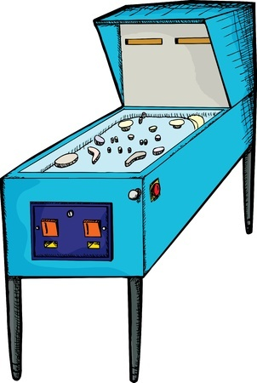

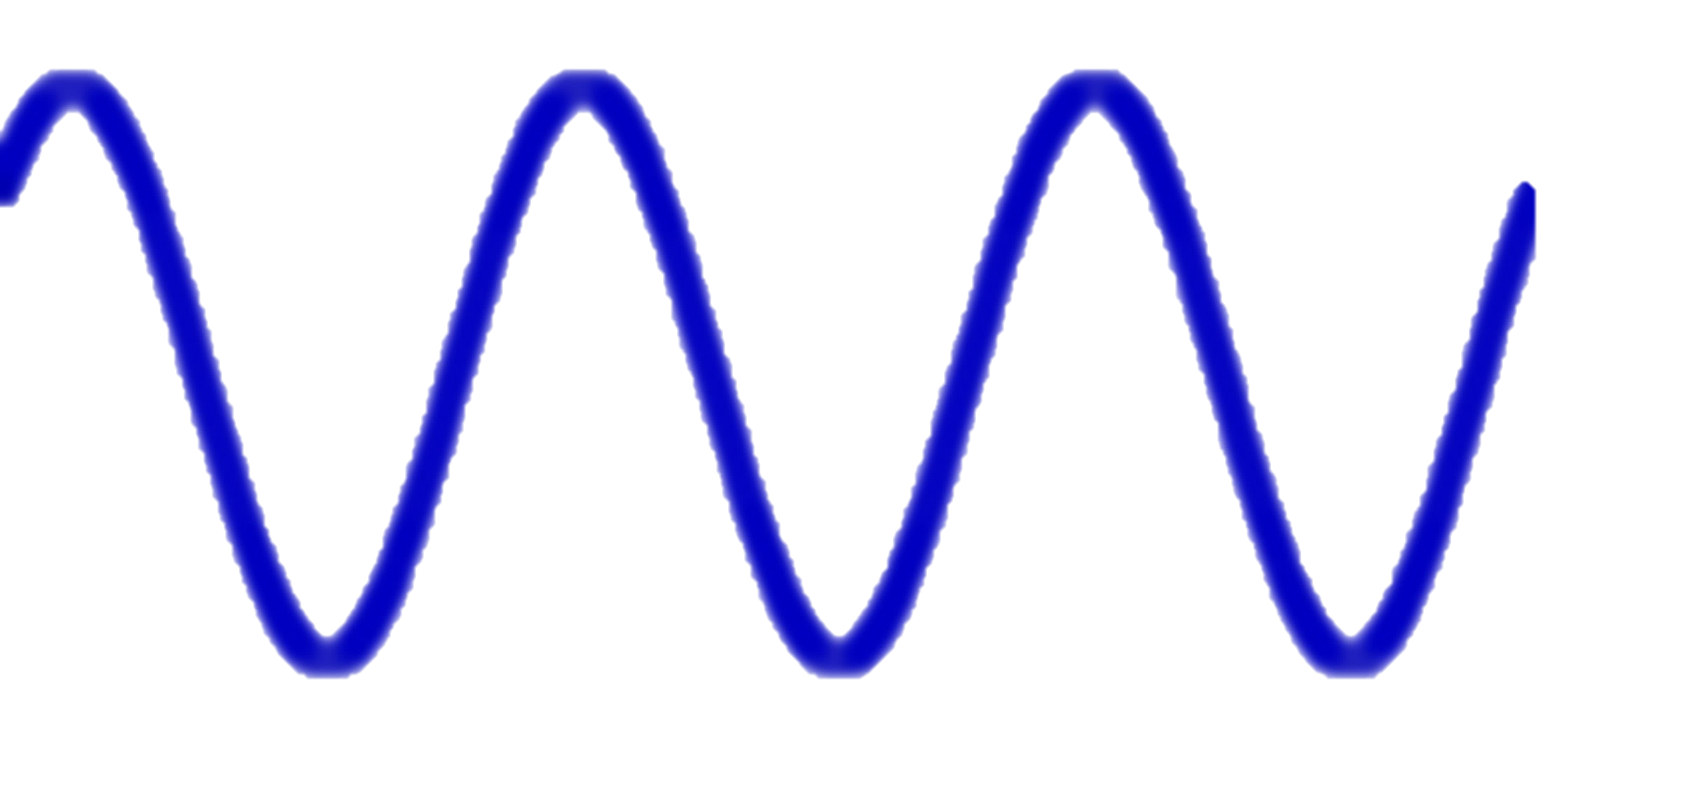
Photoelectric Effect vs. Photoemission
Electron leaves atom if photon (wave packet) has a frequency that corresponds to a high energy.
Notes:
Since energy and mass are equivalent, the Planck constant also relates mass to frequency. By 2017, the Planck constant had been measured with sufficient accuracy in terms of the SI base units, that it was central to the project of replacing the International Prototype of the Kilogram, a metal cylinder that had defined the kilogram since 1889.[7] The new definition was unanimously approved at the General Conference on Weights and Measures (CGPM) on 16 November 2018 as part of the 2019 redefinition of SI base units.[8] For this new definition of the kilogram, the Planck constant, as defined by the ISO standard, was set to 6.62607015×10−34 J⋅sexactly. The kilogram was the last SI base unit to be re-defined by a fundamental physical property to replace a physical artifact.

Slide 12
Photoelectric Effect vs. Photoemission
Electrons excited to higher energy levels or gained by the ion when heated relax, and emit color -- a specific wave packet (photon).

Slide 13
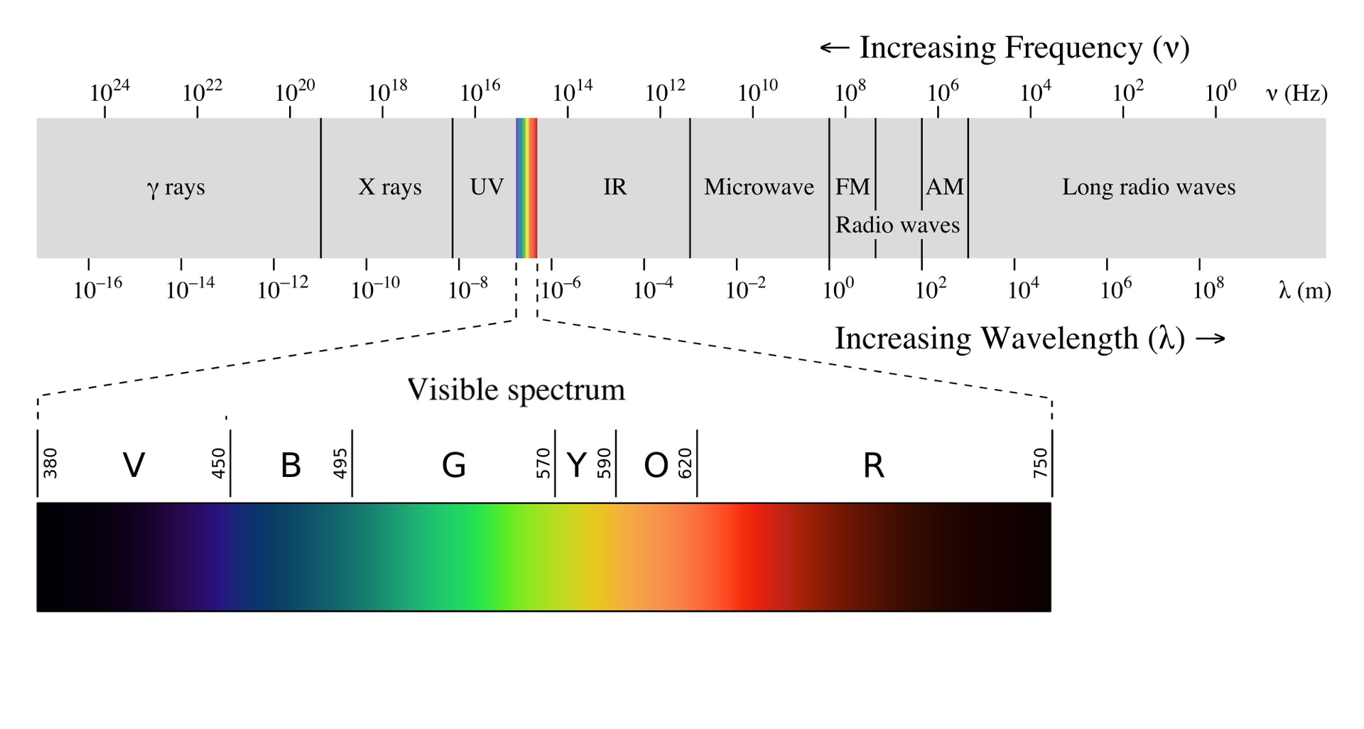
in nanometers (nm)
Image credit: Philip Ronan, Gringer

Slide 14
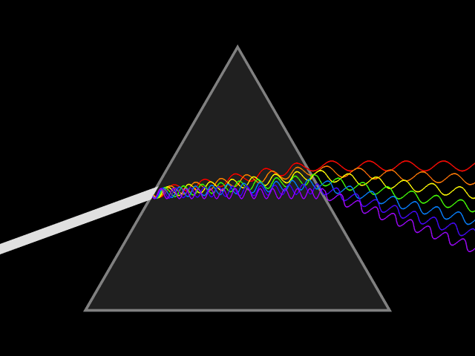

White light is a continuous spectrum.

Slide 15

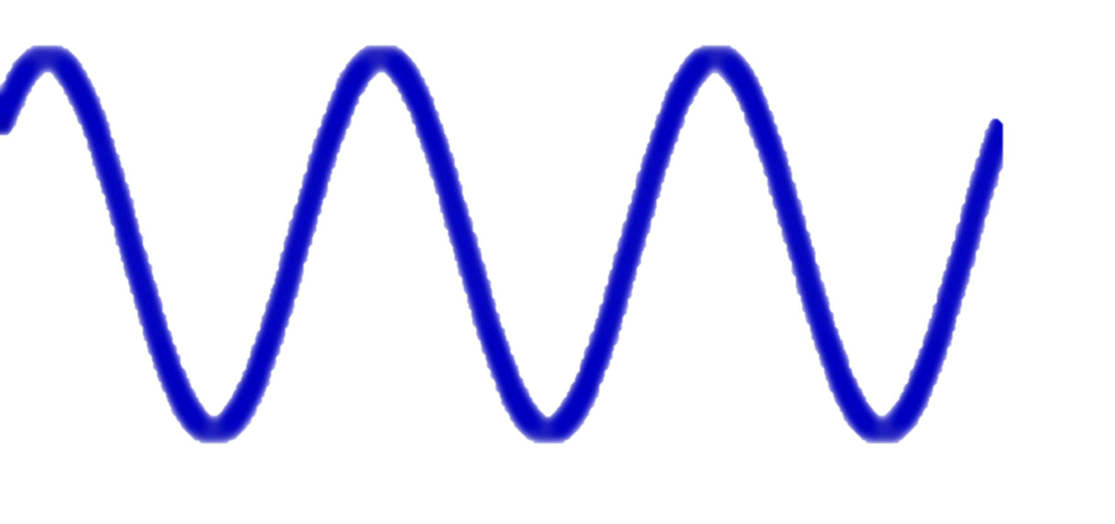

Atoms emit spectral lines because of their energy levels.

Slide 16
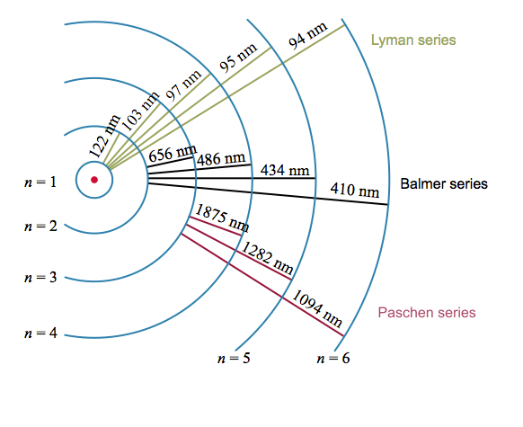
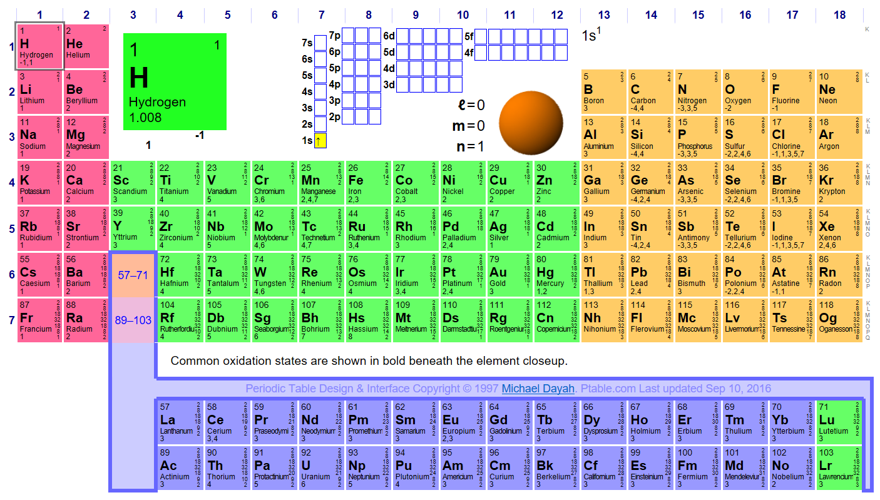
Energy Levels And Orbitals

Slide 18
Each element has a fingerprint.
When an atom or an ion is heated to high temperatures, electrons can be excited to higher energy levels.
Then they relax back to lower levels in one step or in multiple steps.
A corresponding amount of energy is released as light energy with a particular wavelength and frequency.
These jumps produce a spectrum of lines of visible light.
The color you see will be a combination of all these individual colors.
Each element has a fingerprint, a unique spectrum, because each has a different electron configuration.
http://math-science-resources.com/wp-content/uploads/2015/09/Hydrogen-Emission-Lines.png
Notes:
In the case of sodium (or other metal) ions, the jumps involve very high energies and these result in lines in the UV part of the spectrum which your eyes can't see. The jumps that you can see in flame tests come from electrons falling from a higher to a lower level in the metal atoms.
So if, for example, you put sodium chloride which contains sodium ions, into a flame, where do the atoms come from? In the hot flame, some of the sodium ions regain their electrons to form neutral sodium atoms again.
A sodium atom in an unexcited state has the structure 1s22s22p63s1, but within the flame there will be all sorts of excited states of the electrons.
Sodium's familiar bright orange-yellow flame colour results from promoted electrons falling back from the 3p1 level to their normal 3s1 level.
The exact sizes of the possible jumps in energy terms vary from one metal to another. That means that each different metal will have a different pattern of spectral lines, and so a different flame colour.

Slide 19
Emission Spectrum for Hydrogen
Notes:
http://chemistry.bd.psu.edu/jircitano/periodic4.html

Slide 20
in nanometers (nm)
Image credit: Philip Ronan, Gringer

Slide 21
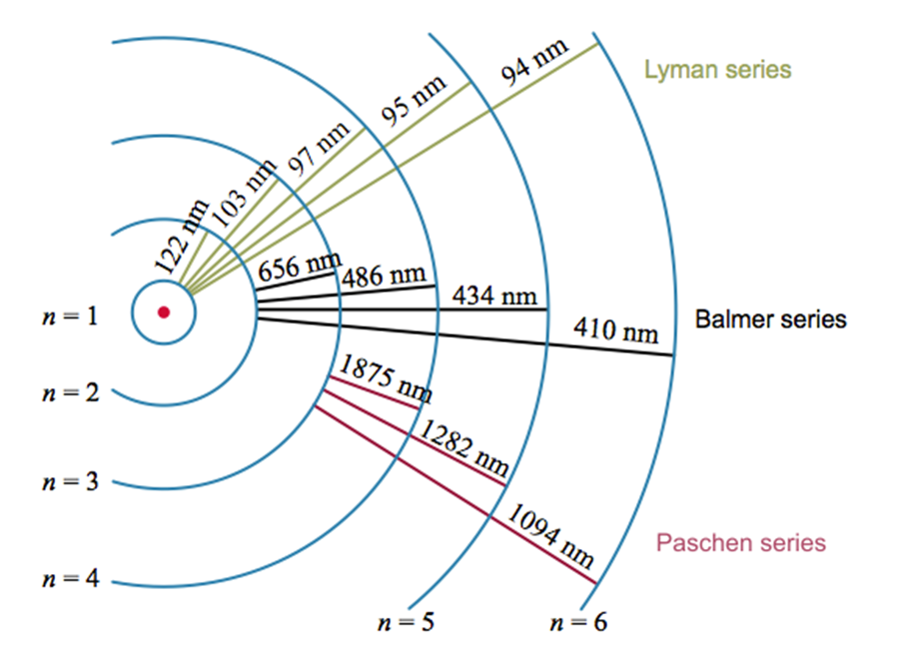

Image credit: Philip Ronan, Gringer

Slide 22
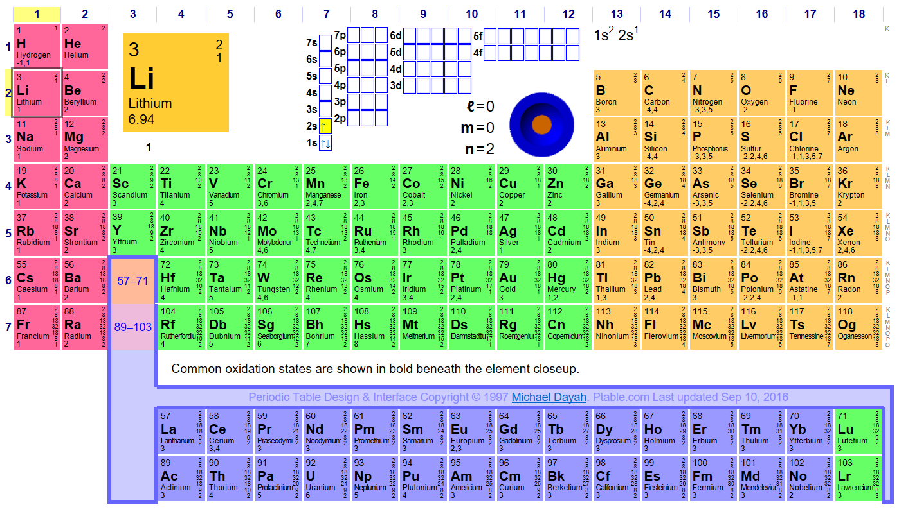

Slide 23
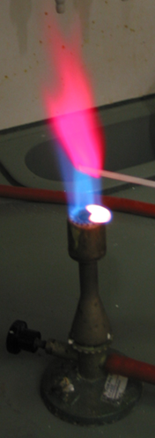

Emission Spectrum for Lithium
Notes:
http://chemistry.bd.psu.edu/jircitano/periodic4.html

Slide 24
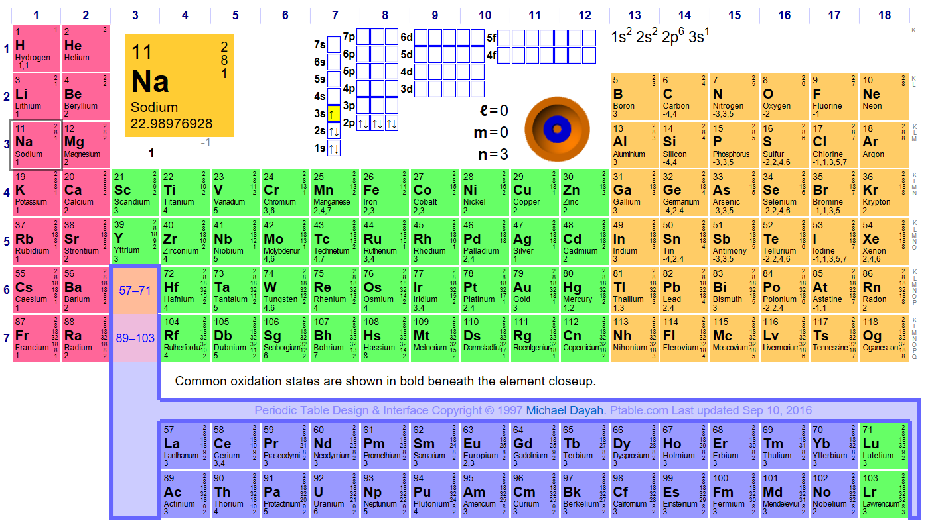

Slide 25
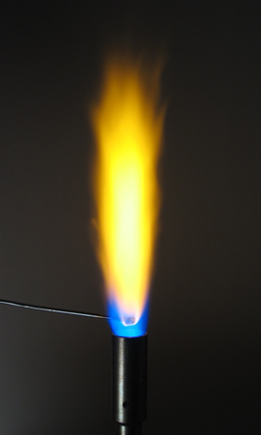

Emission Spectrum for Sodium
Notes:
http://chemistry.bd.psu.edu/jircitano/periodic4.html
http://hyperphysics.phy-astr.gsu.edu/hbase/quantum/orbdep.html#c1

Slide 26
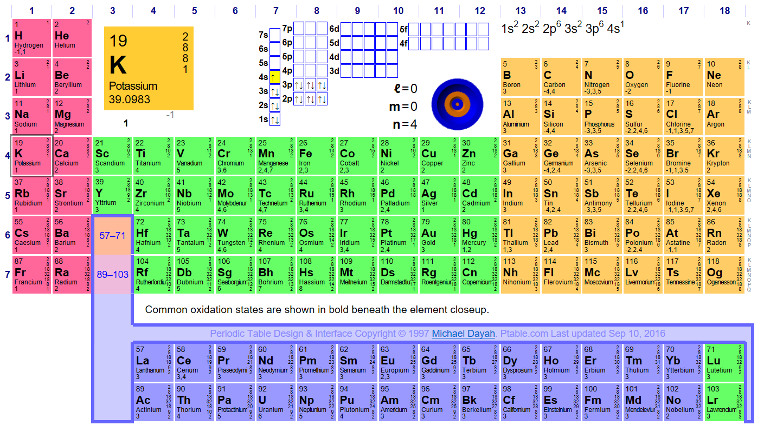

Slide 27
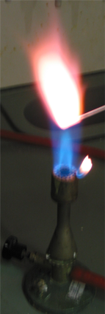

Emission Spectrum for Potassium
Notes:
http://chemistry.bd.psu.edu/jircitano/periodic4.html

Slide 28
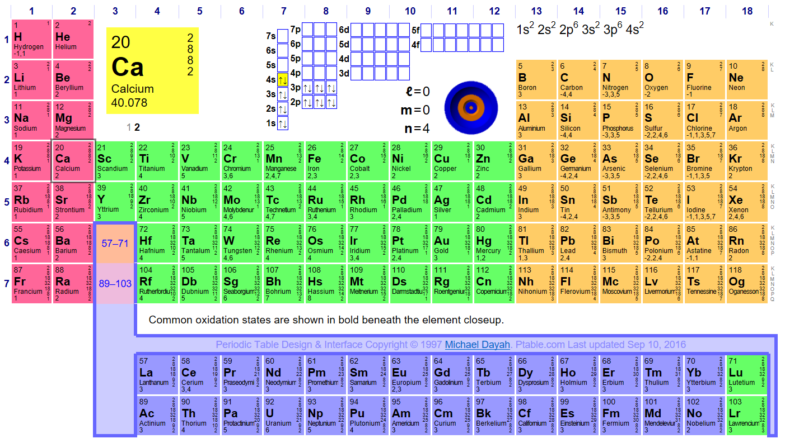

Slide 29
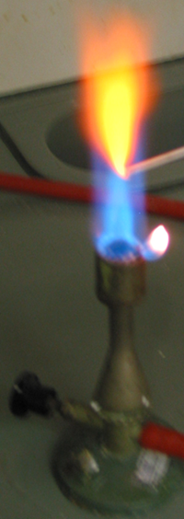

Emission Spectrum for Calcium
Notes:
http://chemistry.bd.psu.edu/jircitano/periodic4.html

Slide 30
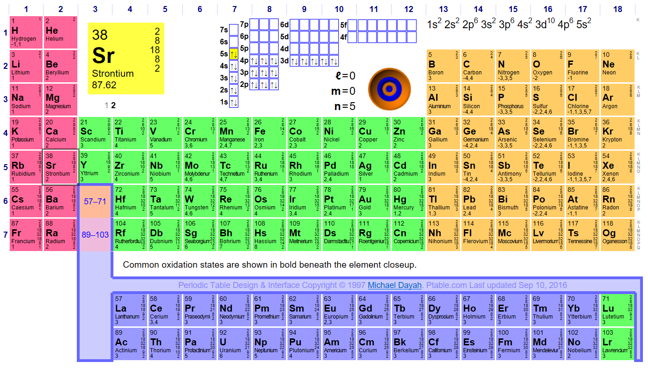

Slide 31


Emission Spectrum for Strontium
Notes:
http://chemistry.bd.psu.edu/jircitano/periodic4.html

Slide 32
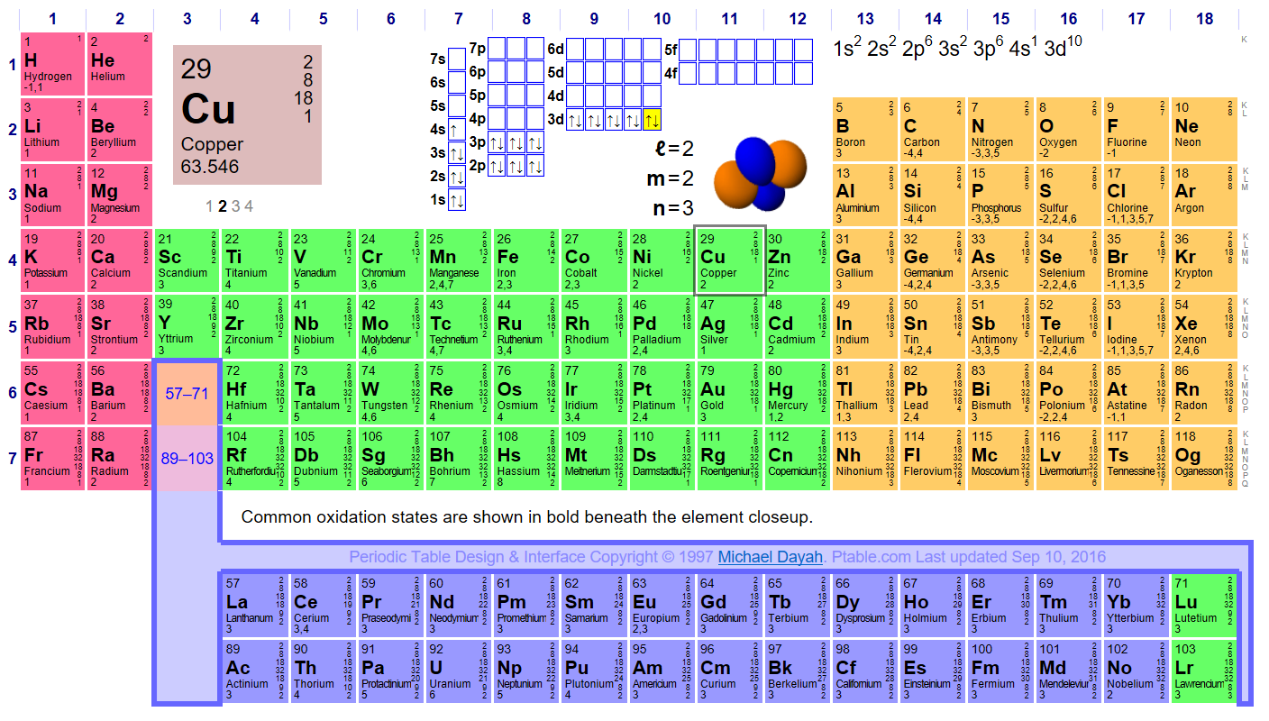

Slide 33
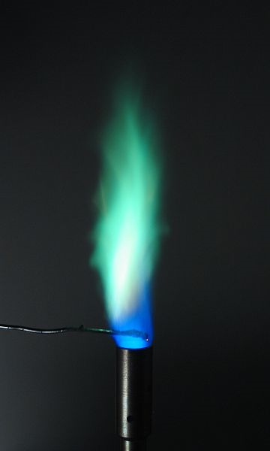

Emission Spectrum for Copper
Notes:
http://chemistry.bd.psu.edu/jircitano/periodic4.html

Slide 34
Observing Quantum Mechanics
When you see the colors, you are seeing the direct consequence of electron excitation between energy levels.

Slide 35
Pre-Lab
Now let's do the flame test.

Slide 36
Safety
Wear goggles.
Wear apron.
Wear gloves.
No sandals.
Pull hair back.

Slide 37
What is a flame test?
Burn stuff!
See pretty colors!

Slide 38
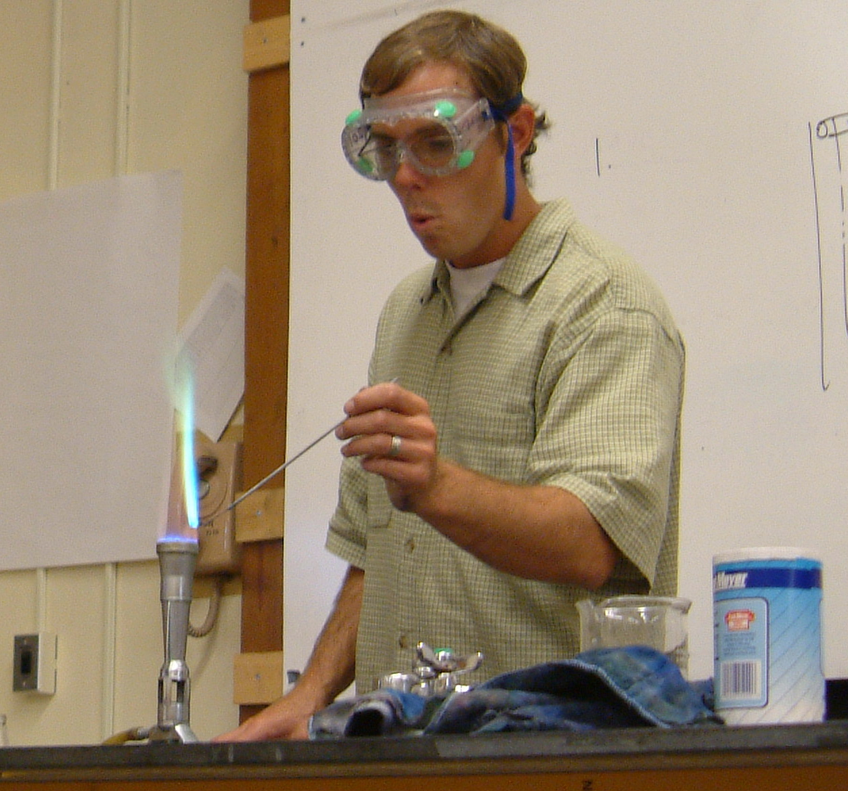
Flame tests ARE really cool.
By No mchine-readable author provided. Burn~commonswiki assumed (based on copyright claims). https://commons.wikimedia.org/w/index.php?curid=298098

Slide 39
What is a flame test?
A flame test is a qualitative analytic procedure used to detect certain metals based on each element's characteristic emission spectrum.
The compound containing the metal is placed in the flame of a gas burner, and a characteristic color is given off visible to the naked eye.
The color is caused by the heat from the flame.
Each element has a unique emission spectrum (A FINGERPRINT) because each element has a unique electron configuration.
Metals that give off color are used in fireworks displays!

Slide 40
Procedure
Sodium chloride
Potassium chloride
Strontium chloride
Calcium chloride
Lithium chloride
Copper(II) chloride
Identify beaker of water (big one).
Identify beaker of hydrochloric acid (small one).
Label white dishes, and fill with metal salts.
Start and adjust Bunsen burner.
Dip nichrome loop into hydrochloric acid to clean.
Place nichrome loop in flame.
Dip loop into acid again and then into compound to test.
Place loop in hottest part of flame.
Observe color.
Record.

Slide 41
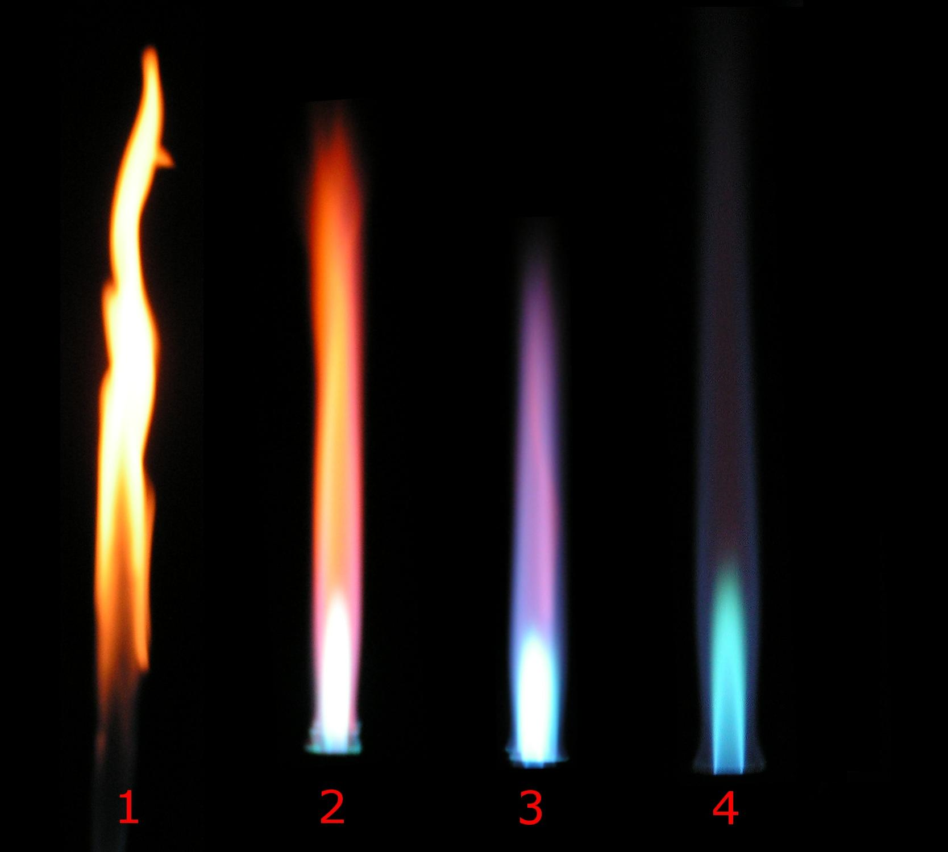
Start and adjust Bunsen burner.*
Make sure gas is coming in.
Adjust collar to provide enough oxygen for the blue (4) flame.
Hottest part of flame
By Arthur Jan Fijałkowski (Own work), via Wikimedia Commons
Notes:
Different flame types of Bunsen burner depending on air flow through the valve:
air valve closed
air valve nearly fully closed
air valve semi-opened
air valve maximally opened

Slide 42
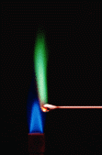
Dip loop into acid again and then into compound to test.**
Repeat these steps until no color is seen.
Do the compounds in this order:
Sodium chloride
Potassium chloride
Strontium chloride
Calcium chloride
Lithium chloride
Copper(II) chloride

Slide 43
Record
What will you notice?
In this order:
Sodium chloride
Potassium chloride
Strontium chloride
Calcium chloride
Lithium chloride
Copper(II) chloride

Slide 44
Determine the unknown
Each group is given a vial with a LETTER LABEL and a salt solution.
Perform the flame test on it by dipping the nichrome loop in the solution and then into the flame.
Try to determine the unknown using your notes from before.

Slide 45
Test a Hypothesis
Based on your observations, predict what will happen when you mix two of the salts. Name the two you plan to mix.
Mix them and conduct the flame test.
Record observations.
Comment on your hypothesis. Did what you expect to happen actually happen.

Slide 46
Record and share your data.
https://tinyurl.com/flametestFNO

Slide 47



Flame Test Metals
Lithium
Sodium
Potassium
Calcium
Strontium
Copper (II) non-halide
Image credits:Wikipedia, Herge, Søren Wedel Nielsen

Slide 48
Post-Lab
Put it all together.

Slide 49
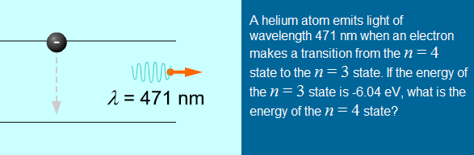
PHOTONS AND ELECTRON ENERGY LEVELS
Principles of Physics Online version 2.20.002 | © 2001-2010 Kinetic Books Company | Chapter 41.12

Slide 50
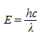
Express the energy in joules.
E = ((6.63 × 10⁻³⁴ J∙s)(3.00×10⁸m/s) / (471 × 10⁻⁹ m) ) = 4.22 × 10⁻¹⁹ J
Express the energy in electron volts, as is commonly done for atomic-level calculations.
E = (4.22 × 10⁻¹⁹ J)(1 eV/1.60×10^{–19} C) = 2.64 eV
Write the equation that expresses the change in energy of the electron.
ΔE = E_{f} – E_{i}
The atom loses energy as the electron drops from n = 4 to n = 3, so its change in energy is negative. By the conservation of energy, the energy of the photon is the opposite of the change in the atom’s energy.
–E_{photon} = E_{f} – E_{i}
– 2.64 eV = -6.04 eV – E_{i}
E_{i} = -3.40 eV
Principles of Physics Online version 2.20.002 | © 2001-2010 Kinetic Books Company | Chapter 41.12

Slide 51
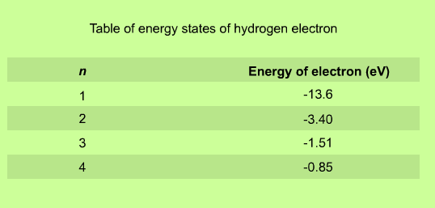
Principles of Physics Online version 2.20.002 | © 2001-2010 Kinetic Books Company | Chapter 41.12
Notes:
These are the first four energy levels of a hydrogen atom. They correspond to the orbits you just saw. These are the discrete energy levels at which a single hydrogen atom can exist. For instance, it is not possible for an electron to have -13.0 eV as its energy. We only list the first four energy levels; however, there are actually an infinite number of energy levels for the electron. We thought it might be a bit time consuming to list them all.

Slide 52
Emission Spectroscopy
Works for ~70 elements
Atomic Emission Spectroscopy works in the parts-per-million to parts-per-billion range.
Methods are rapid, convenient, and selective.
Can be performed only on gaseous medium in which atoms (or ions) are well separated from each other.
Atomization done by flame.

Slide 53
Emission Spectroscopy
Samples produce atomic absorption, emission, and fluorescence spectra.
Atomic spectra are simpler than molecular spectra because vibrational and rotational states and transitions cannot exist in the absence of chemical bonds.
Molecular spectra are complicated by additional possible energy transitions.
Produce spectral bands.
Notes:
As well as the electronic transitions discussed above, the energy of a molecule can also change via rotational, vibrational, and vibronic (combined vibrational and electronic) transitions. These energy transitions often lead to closely spaced groups of many different spectral lines, known as spectral bands. Unresolved band spectra may appear as a spectral continuum.

Slide 54
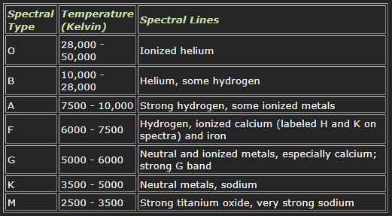
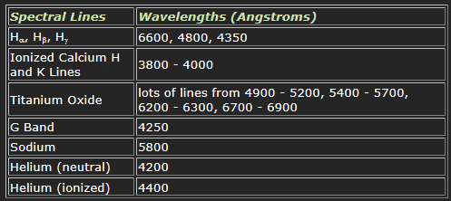
Astronomical Spectroscopy
Stars emit light with different wavelengths.
Elements up to iron are made in stars as nuclei fuse (nucleosynthesis).
In hot stars, hydrogen atoms become ionized. No electrons = no absorption of light.
In cool stars, electrons do not excite. No excitations = no emission of light.
The temperature of a star can be determined by emission spectra. Elements have a certain temperature where emission and absorption are strongest.
So, stars can be classified.
Built on the Secchi classes (Fr. Pietro Angelo Secchi)
Source: Sloan Digital Sky Survey | SkyServer | Spectral Lines (http://skyserver.sdss.org/dr2/en/proj/advanced/spectraltypes/lines.asp)

Slide 55
What do flame tests have to do with God?

Slide 56
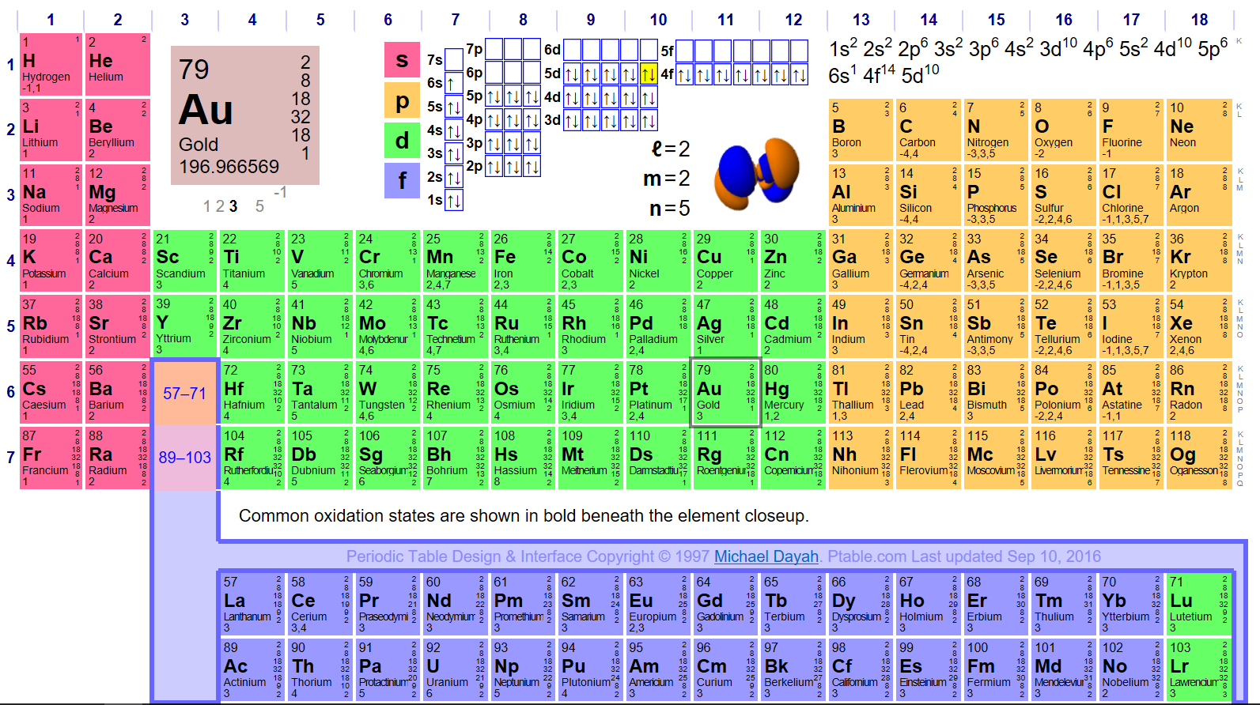
“…but thou hast ordered all things in measure, and number, and weight.” Wisdom 11:21

Slide 57

“…one who had seen eyes only on plates would never really have known them at all…” —Frank J. Sheed, Theology and Sanity (San Francisco: Ignatius Press: 1946), 25.

Slide 58
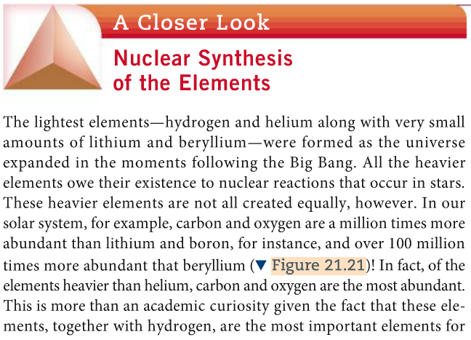
“created equally”
Brown, LeMay, Bursten, Murphy, Woodward, Stoltzfus, Chemistry: The Central Science, 13th Edition (Pearson: 2016).

Slide 59
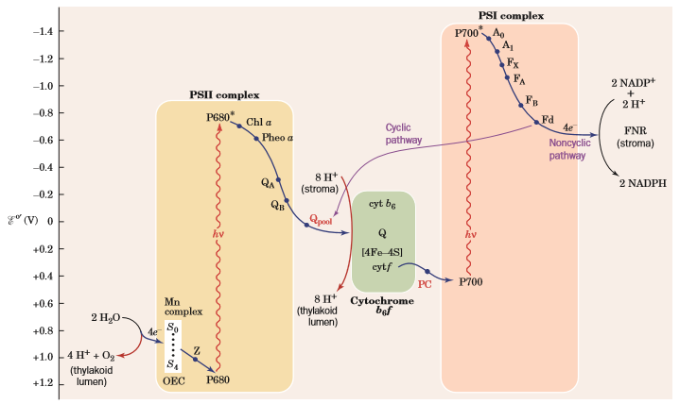
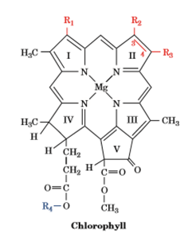
Electron Transfer
Donald Voet, Judith G. Voet, Charlotte W. Pratt, Fundamentals of Biochemistry: Life at the Molecular Level, 4th Edition (Wiley, July 2015, ©2013), p. 641.
Notes:
The very oxygen we breathe is produced by photosynthesis in chloroplasts that evolved from bacteria. This evolution over the eons generated the oxygen in the Earth’s atmosphere. How? In the chloroplasts (half a million or so per square millimeter) of plant leaves, for example, the chlorophyll molecules in the thylakoid membranes absorb photons from the full spectrum of visible light from the sun.
The double bonds in the carbon rings of the chlorophylls provide (P680), basically, a place for electrons to hang out—like a shopping mall—and the metal ion provides extra electrons, so some of them want to get away.
The light energy (captured as photons) gets the already enthusiastic electron even more excited, and they are like, “I’m out of here.”
The electron is transferred to another protein molecule, and then to another and another and another and so on, much as people might toss a hot potato down a line.
Each passing of the potatoes, so to speak, allows some energy to be lost, but not wasted. The controlled release of energy is used to power other reactions.
These molecules are the solar batteries that keep life pumping. My research in graduate school involved the synthesis of artificial photosynthesis composites. In our state of the art laboratory, we achieved 30% quantum yield with a charged separated state of 25 microseconds, and that was publishable in the Journal of the American Chemical Society. By contrast, in leaves, protein complexes in the chloroplasts orient chlorophyll molecules at exactly the right angstrom-scale spacing so that when photons excite electrons, the electrons are passed to reaction centers in less than a tenth of a nanosecond with an efficiency of >90%.

Slide 60
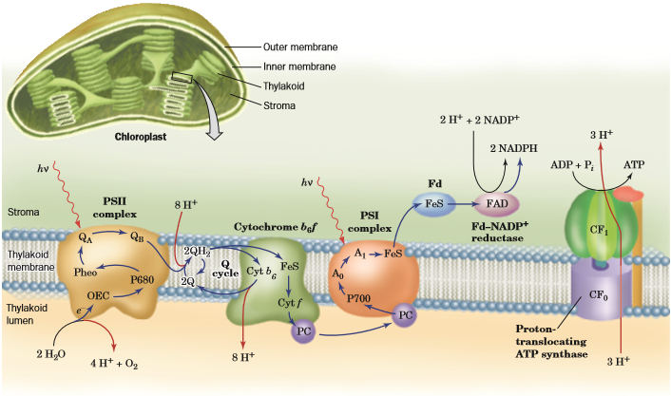
Photosynthesis
Donald Voet, Judith G. Voet, Charlotte W. Pratt, Fundamentals of Biochemistry: Life at the Molecular Level, 4th Edition (Wiley, July 2015, ©2013), p. 640.
Notes:
Electrons enter the Z-scheme, a complex dual system of electron transfer pathways that directs energy for chemical reactions. Oxidized pigment molecules strip electrons off water (H₂O) to generate oxygen gas (O₂). The conversion of nicotinamide adenine dinucleotide phosphate (NADP+) to NADPH generates a transmembrane proton gradient, which supplies the energy for the synthesis of adenosine triphosphate (ATP) from adenosine diphosphate (ADP) and a phosphate group donor. NADPH reduces ATP and captures carbon dioxide (CO₂) from the atmosphere to fix carbon into the precursors of carbohydrates. Carbohydrates store energy and form structural components, such as dietary fiber and the 5-carbon monosaccharide ribose in the backbone of ribonucleic acid (RNA) and deoxyribonucleic acid (DNA), the stuff of genetics. Photosynthesis fuels the work of life, consuming about six times more energy globally than humans each year, using some quintillion kJ of energy to react ~100 billion tons of carbon.

Slide 61
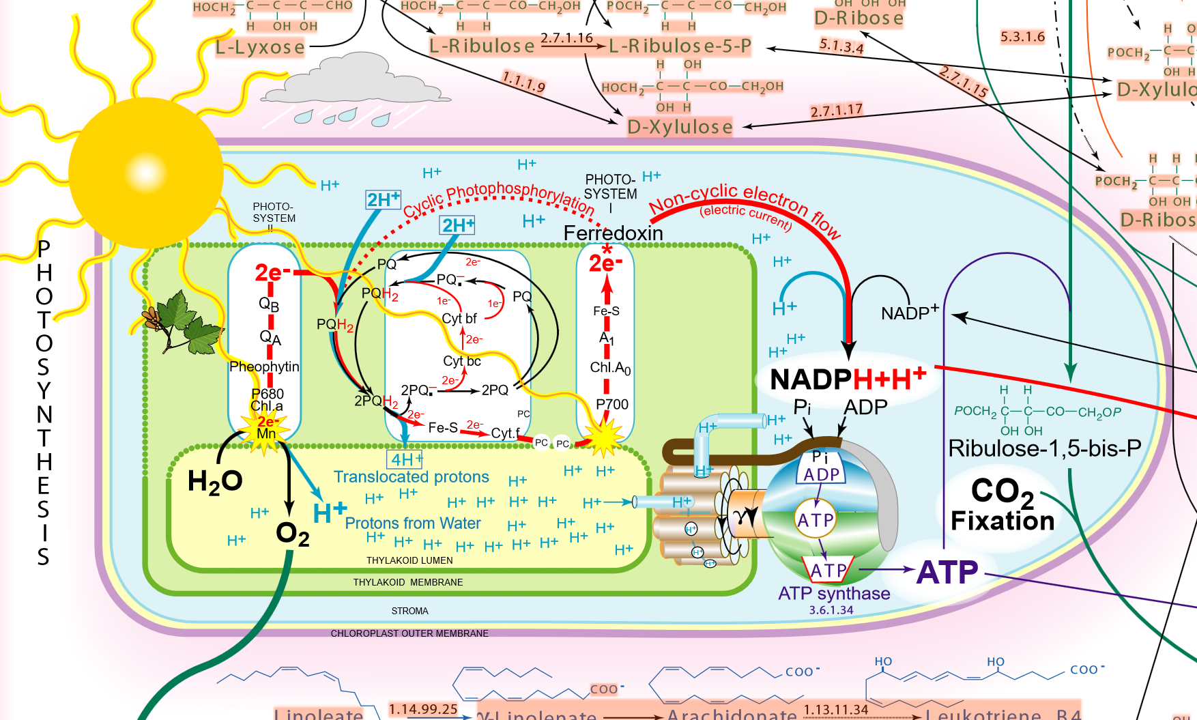

Slide 62
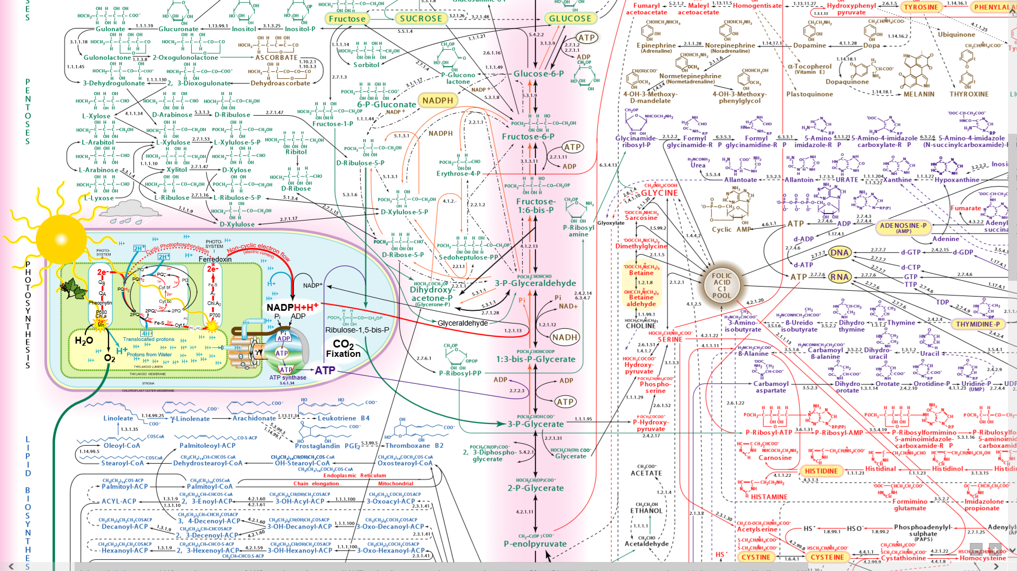
The 22nd (2003) edition of the IUBMB-Sigma-Nicholson Metabolic Pathways Chart

Slide 63


Slide 64
“For he hath given me the true knowledge of the things that are: to know the disposition of the whole world, and the virtues of the elements, the beginning, and ending, and midst of the times, the alterations of their courses, and the changes of seasons, the revolutions of the year, and the dispositions of the stars, the natures of living creatures, and rage of wild beasts, the force of winds, and reasonings of men, the diversities of plants, and the virtues of roots, and all such things as are hid and not foreseen, I have learned: for wisdom, which is the worker of all things, taught me.”
Wisdom 7:17-21
Notes:
As it was in the beginning, is now, and ever shall be, world without end. Amen.

Slide 65

“By stimulating wonder before the profound mystery of creation, faith broadens the horizons of reason to shed greater light on the world which discloses itself to scientific investigation.” —Pope Francis, Lumen Fidei (34)

Slide 66
Science in the Light of Faith

Slide 67
Science is the study of the handiwork of God.

Slide 68
Pray the Creed and mean it.

